Slide 1
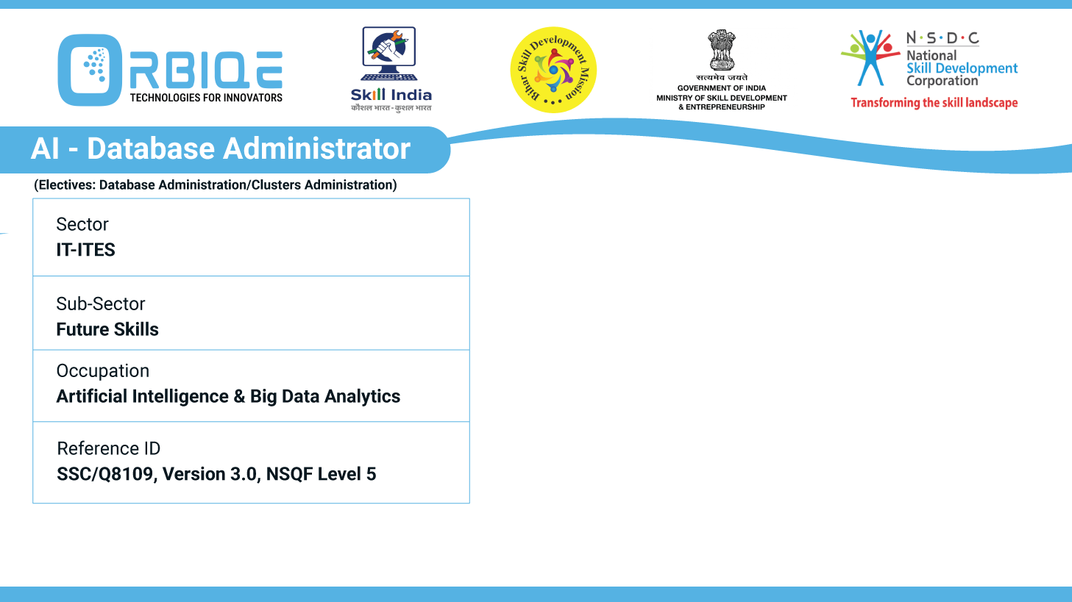
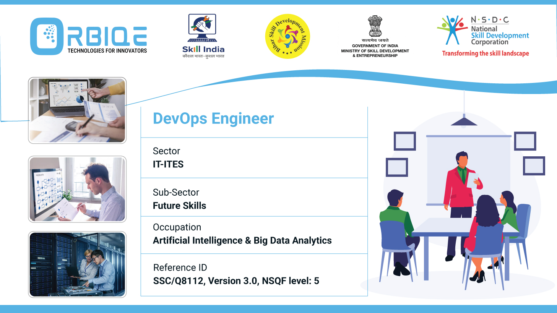
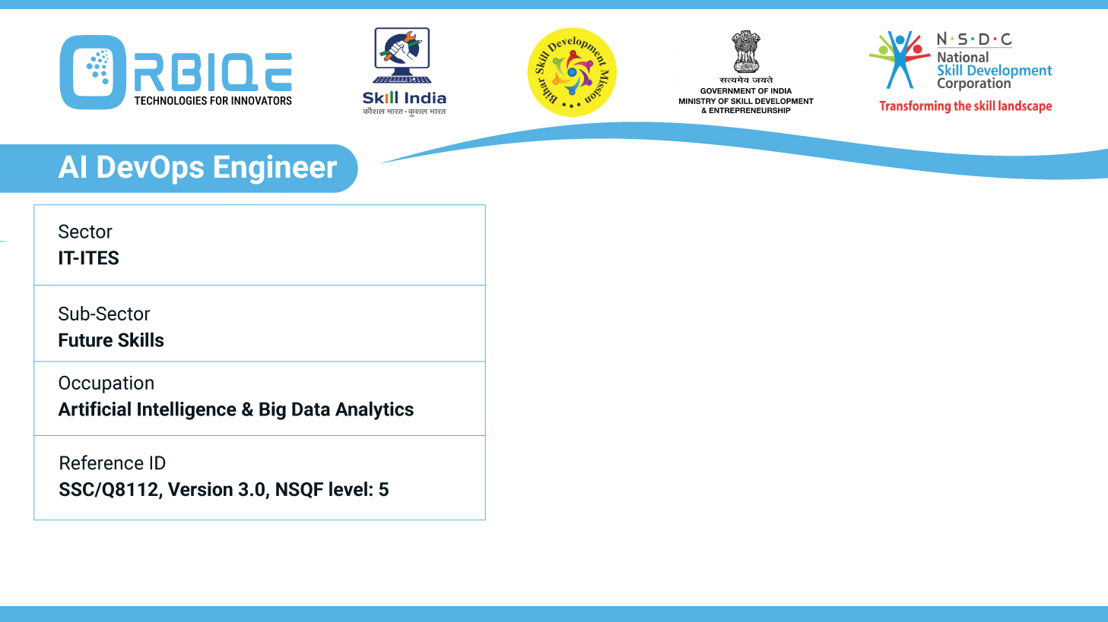
Name- Krishna Kant Dubey

Slide 2

Mapping the Data Landscape: Internal Sources and Beyond

Slide 3
Agenda
Identify and leverage internal data sources such as data
warehouses, web servers
Various file types, recognizing their role in AI Database
Administration

Slide 4
various external data sources, including public, open-source, private
Public Data Sources
Openly available to anyone, often maintained by government or international organizations
Open-Source Datasets
Freely distributed, commonly used for AI, ML, and research projects
Private/Proprietary Data
Accessible only with permission or subscription

Slide 5
Applications of relational and NoSQL databases in different contexts
Relational Databases (RDBMS)
These are structured, table-based systems like PostgreSQL, MySQL, SQL Server
Enterprise Systems: Finance, HR, CRM where data consistency is critical
Data Warehousing: Structured reporting, especially when using SQL-based analytics
E-commerce Platforms: Order processing, inventory, and customer data that rely on ACID transactions

Slide 6
Applications of relational and NoSQL databases in different contexts
NoSQL Databases
These are schema-less systems designed for scalability, like MongoDB (document), Redis (key-value), Cassandra (column), Neo4j (graph)
Real-Time Applications: Chat apps, social media feeds, gaming—where speed and scalability matter more than strict consistency.
IoT Systems: Handling massive streams of loosely structured sensor data

Slide 7
Document-Oriented NoSQL Database Use Case
MongoDB
MongoDB is a powerhouse when it comes to handling flexible, high-volume, and fast-changing data. Here are some standout real-world use cases where MongoDB truly excels
E-commerce Platforms
Recommendation engines using real-time user behavior
Mobile & Social Media Apps
User-generated content like posts, comments, and likes

Slide 8
Graph Database Use Case(Neo4j)
Fraud Detection
Track complex transaction patterns across accounts.
Identify suspicious behavior by analyzing connections between
users, devices, and locations.
Real-time anomaly detection using relationship graphs.
Social Network Analysis
Model users, friendships, likes, shares, and comments as nodes and edges.
Discover influencers, communities, and engagement patterns.

Slide 9
Thank You

